Slide 1
Brazilian Company for Research and
Industrial Innovation
Funding Opportunities for Research Centres and SMEs
24th May 2022
ANA ARROIO
Head of International Cooperation

Slide 2
EMBRAPII’S GOALS
Support companies in the development of innovative technologies for development of products;
Increase competitiveness of companies in national and international markets;
Focus on business demands;
To offer flexible, agile and no bureaucratic cooperative partnership;
Share risks and costs of investing in industrial innovation;
To attract private investment in innovation.

Slide 3
EMBRAPII UNITS: NETWORK OF SELECTED APPLIED RESEARCH CENTERS
Technical Excellence
Technological focus
Strong technological capabilities
Expertise in collaboration with companies
Project management skills
Agility: for project negotiation & contracting
Very competitive selective process
Accreditation for several years upon evalaution

Slide 4
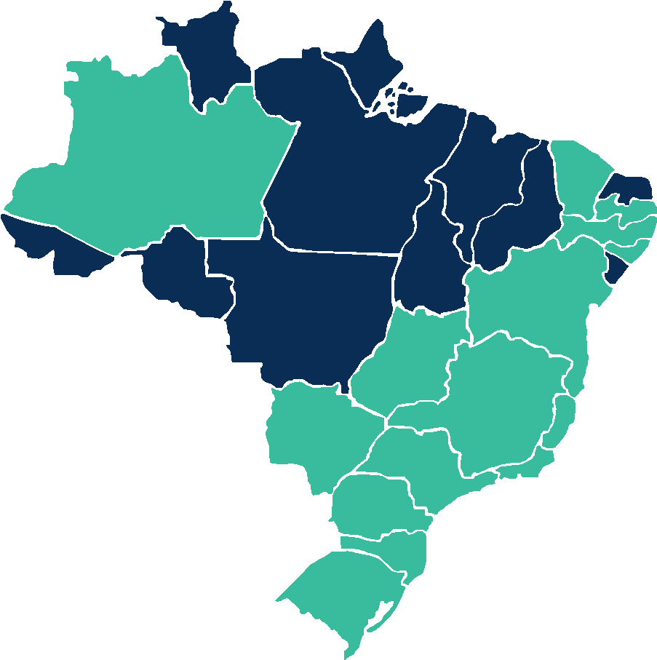
COMPETENCE AREAS
CEARÁ
♦ Embedded Systems and Digital Mobility
♦ Complex Embedded Systems
AMAZONAS
♦ Technologies for Manufacturing Processes
♦ Manufacturing Automation Systems
PARAÍBA
♦ Software and Automation
♦ Manufacturing Systems
PERNAMBUCO
♦ Connected Products
♦ Vehicle Systems and Technologies
ALAGOAS
♦ Industrial Computing
BAHIA
♦ Health Technologies
♦ Integrated Manufacturing
DISTRITO FEDERAL
♦ Biochemistry of Renewable Materials
GOIÁS
♦ Artificial Intelligence
♦ Agroindustrial Technologies
♦ Industrial Energy Technologies
MINAS GERAIS
♦ Software for Cyberphysical Systems
♦ Forest Fibers
♦ Metal-mechanical Technologies
♦ Agri-food Solutions
♦ Coffee Agroindustry
♦ Mobility and Intelligent Systems
♦ Digital Communications
♦ Steel and Special Alloys
♦ Digital Agriculture
♦ Technologies applied to Eletric and Hybrid Powertrain to Biofuels
SÃO PAULO
♦ Eco-efficient Construction
♦ Polymers and Nanomaterials
♦ Biotechnology
♦ Advanced Communications
♦ Pharmaceutical Drugs and Biopharmaceutical
♦ Polymeric and Functional Materials
♦ Equipment for Internet and Mobile Computing
♦ Agricultural Pest Biocontrollers
♦ Food Technology and Engineering
♦ Biophotonics and Instrumentation
♦ Biotechnological Processes
♦ High-Performance Materials
♦ Sustainable Materials Technology
♦ Green Chemistry
♦Materials
♦ Power Transmission
♦ Technologies Associated to Powertrains
ESPÍRITO SANTO
♦ Metallurgy and Materials
MATO GROSSO DO SUL
♦ Biomass Transformation
RIO DE JANEIRO
♦ Oil and Gas Engineering
♦ Cleaner Production Technologies
♦ Industrial Chemical Technology
♦ Innovation in Biosynthetic and Fibers
♦ Green Chemistry Technologies
♦ Computational Engineering Solutions
PARANÁ
♦ Embedded Electronics
♦ Industrial Electrochemistry
SANTA CATARINA
♦ Intelligent Systems
♦ Medicines
♦ Intelligent Energy Systems
♦ Embedded Systems
♦ Laser Manufacturing
♦ Innovative Refrigeration Technologies
RIO GRANDE DO SUL
♦ Distributed Energy Resources
♦ Sensing Systems
♦ Polymers
♦ Robotics Systems and Automation
♦ Pipeline Technology
♦ Polymeric Materials and Nanomaterials

Slide 5
EMBRAPII SEVEN YEARS OF OPERATION*
+ R$ 2,11 Billions
Invested in R&D projects
1.886
Projects supported
EMBRAPII Participation | Companies Participation | EMBRAPII Units Participation
R$ 815,0 millions
R$ 180,4 millions
R$ 446,1 millions
1.425
33,3%
49,2%
18%
reducing business risk and cost
leveraging private investment
Contracting companies
Concluded projects
676
Industrial Property Rights
+1.000
*Data: May 2022

Slide 6
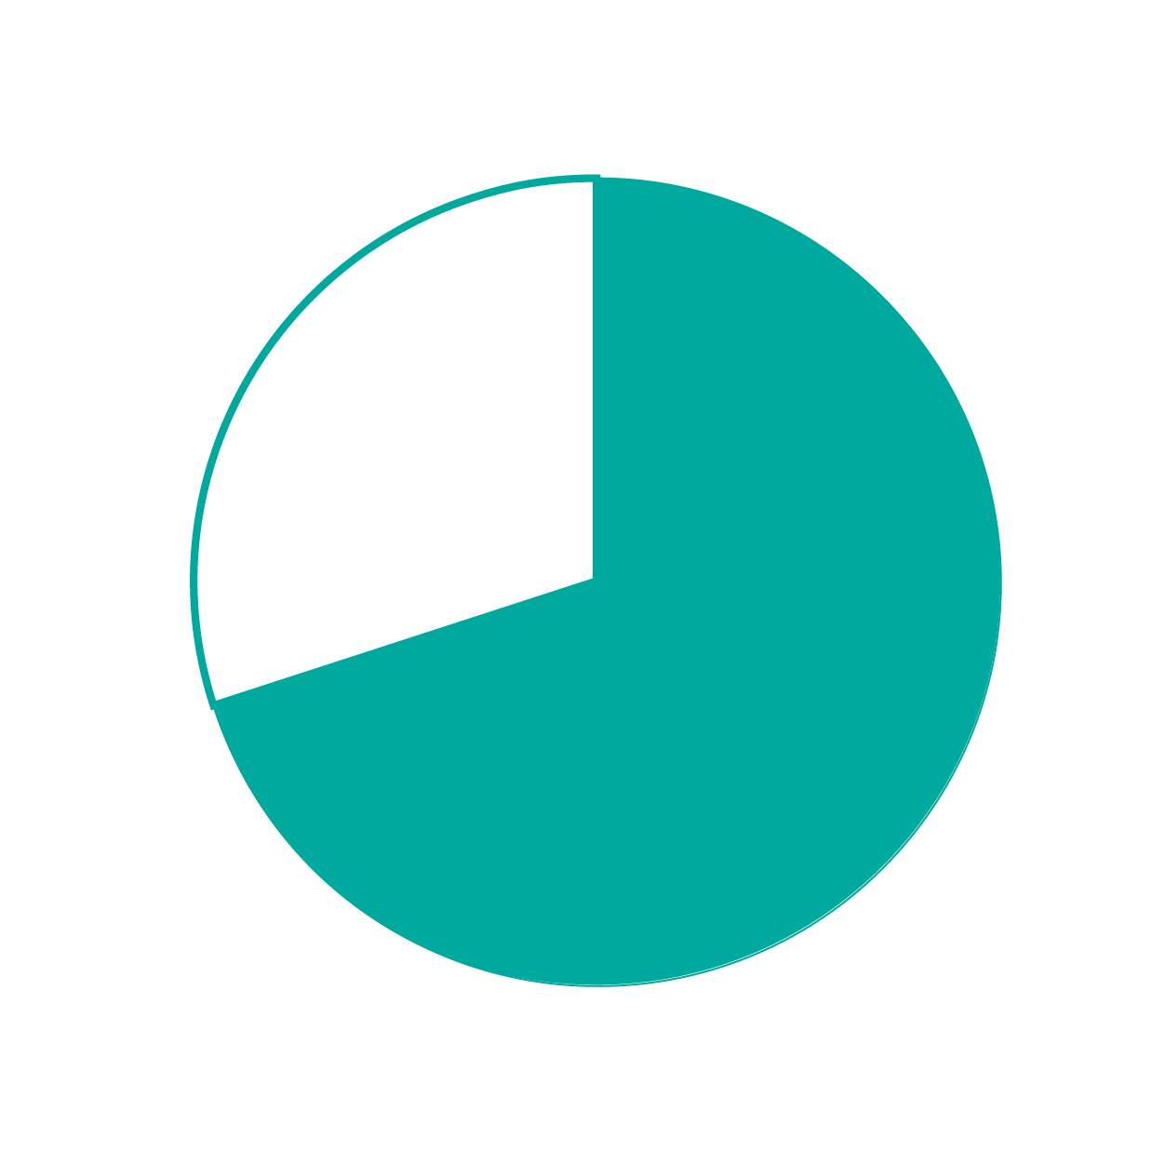
INTERNATIONAL COOPERATION

Slide 7
International Collaboration Projects
R&D
projects
EMBRAPII
R&D UNIT
COMPANY
INTERNATIONAL
COMPANY
$
$

Slide 8
TECH TALK
Which are the international partnership options currently available?
Innosuisse (Switzerland)
GlobalStars (Belgium, Finland, Holand, Portugal Turkey and Spain)
34th Cornet and 30th IraSME Calls to open soon
How to identify an EMBRAPII Unit to present the issue?
It is up to the company to talk with the representatives of the EMBRAPII Unit to define which one is best suited to the project. EMBRAPII can help matchmaking
How to identify an international partner company?
EMBRAPII promotes webinars, workshops and events to help matchmaking between Brazilian and international companies.
To whom will the intellectual property of the developed product belong?
The IPR must be negotiated between the parties involved, including the companies, the international funding agency and the EMBRAPII Unit.

Slide 9
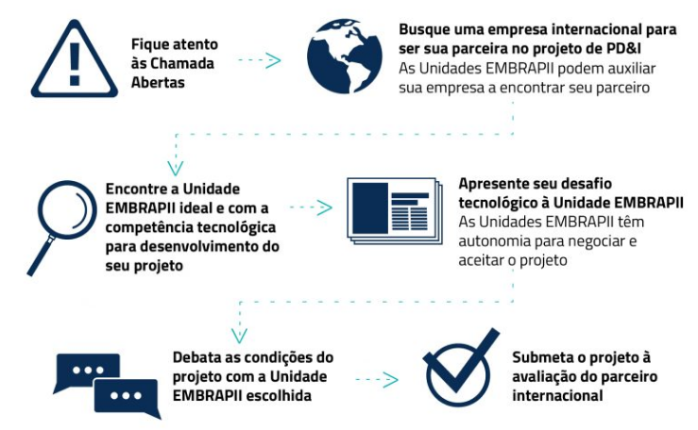
Look for an international company to be your partner in the R&D project
Embrapii Units can help your company to find its partner
Follow the open calls
Find the ideal EMBRAPII Unit with the technological competence to develop your project
Present your technological challenge to the EMBRAPII Unit
Embrapii Units have the autonomy to negotiate and accept the project
Discuss the project conditions with the chosen EMBRAPII Unit
Submit the project to the evaluation of the international partner

Slide 10
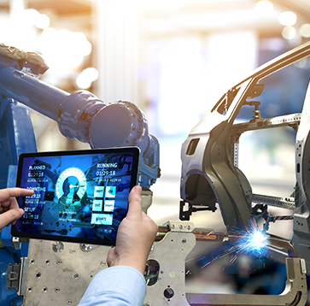
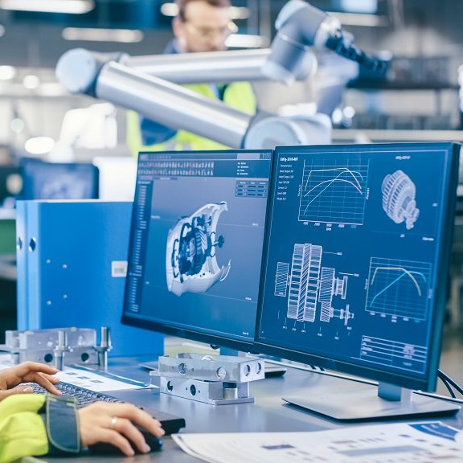
31st EMBRAPII - CORNET Call
High performance compression molding and machining of thick CFRP components for structural applications
Self-improvement quality for under measure fiber placement composite production
EMBRAPII Unit
9 Brazilian and German PMEs
EMBRAPII Unit
12 Brazilian and German PMEs
German partner
FRAUNHOFER INSTITUTE FOR PRODUCTION SYSTEMS AND DESIGN TECHNOLOGY
German partners
FIBRE, Leibniz IPF, IWK

Slide 11
32nd EMBRAPII – CORNET CALL
Projeto: Development and Industrialization of High Productivity Laser Material Deposition (HIPLMD)
Unidade EMBRAPII: ISI Laser
Empresas e Instituições brasileiras parceiras:
FIESC, ILS, UFSC, IFSC, COMAC, HRC, Calwer Mineração, Mineração Rio do Ouro, Granaço, Pauluzzi Produtos Cerâmicos, Rio Deserto, Librelato, Vulkan, VALE, Netzsch, Höganäs Brazil.
Empresas e Instituições alemãs parceiras: DVS, ILT, TIME, Durum, GTV, Innojoin LMB Automation, SKLT, Rio, Deloro Wear Solutions, KUKA Industries, Laserline, Siemens AG, Coherent.

Slide 12
THANK YOU!
Inter.coop@embrapii.org.br
More informations:
www.embrapii.org.br
Edifício Armando Monteiro Neto - SBN, quadra 01, bloco I, 13º e 14º andares, Asa Norte, Brasília, DF
Telefone: (61) 3772-1000

