Slide 1
Interreg Europe
Nicolas Singer | Senior Project Officer
Interreg Europe Secretariat
24 April 2015

Slide 2
Interreg Europe
Context
Overall strategic framework: EU2020 strategy
SMART GROWTH
Economy based on knowledge & innovation
GREEN GROWTH
Resource efficient, greener and more competitive economy
INCLUSIVE GROWTH
High-employment economy delivering social and territorial cohesion
3 pillars translated in 11 Thematic Objectives in 2014-2020 regulation

Slide 3
Interreg Europe
Convergence of EU policies
1. New objective set for interregional cooperation
2. Concentration principles
INTERREG
EUROPE
3. Smart Specialisation strategies
4. Integration of Regions of Knowledge (RoK)

Slide 4
Interreg Europe
Rationale
Policy learning among public authorities to improve performance of policies & programmes for regional development, in particular Structural Funds programmes
Policy learning among public authorities to improve performance of policies & programmes for regional development, in particular Structural Funds programmes
EU Cohesion policy
Goal 1: Investment for growth & jobs (G&J)
EUR 340 billion
Goal 2: European Territorial Cooperation (ETC)
EUR 10.2 billion
INTERREG EUROPE
EUR 359 m
€

Slide 5
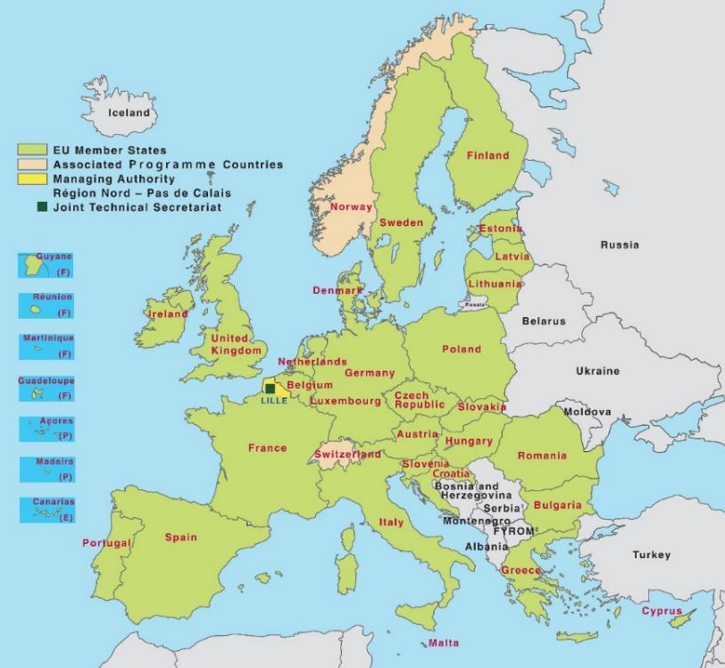
Interreg Europe
Eligible area
EU28 + Norway & Switzerland

Slide 6
INTERREG EUROPE
…S3
innovation infrastructure
innovation chains…
Thematic focus
4 priority axes
…creation,
development,
growth of SMEs…
Research and innovation | SME competitiveness
Low-carbon economy | Environment and resource efficiency
…energy efficiency
renewable energies
sustainable transport…
…natural heritage
cultural heritage
resources efficiency…

Slide 7
Interreg Europe
2 actions
A. Interregional Cooperation Projects
B. Policy Learning Platforms

Slide 8
Interreg Europe
Budget per action
Programme total ERDF budget: MEUR 359
ERDF budget for platforms: MEUR 15.3 (max)
ERDF budget for projects: MEUR 322.4 equally shared over 4 priority axis (MEUR 84)

Slide 9
Interreg Europe
Projects
Definition
Partners from different countries working together on a shared regional policy issue (within the thematic fields of the programme)…
Objective
….to improve the effectiveness of the policies of the regions involved in the project (in particular their Investment for Growth and Jobs goal programmes)

Slide 10
Interreg Europe
Project organised in 2 phases
Phase 1
(1 to 3 years)
Exchange of experience ending up with the production of 1 action plan / region
Monitoring of the action plan implementation
+ possible pilot actions
Phase 2
(2 years)

Slide 11
Interreg Europe
Projects partnership features
From at least 3 countries, from which at least 2 partners from EU-MS
Recommendation: between 5 to 10 partners
Advisory partners:
offer a particular competence that can facilitate the project’s implementation
do not address a policy instrument and therefore do not need to develop an action plan.
Stakeholder group: one per region

Slide 12
Interreg Europe
Projects partnership: who is eligible?
Public bodies (the main target group) (e.g. local, regional, national authorities)
Bodies governed by public law (Directive 2004/18/EC)
Private non profit bodies
Confirmation of the eligibility status:
check with your contact point

Slide 13
Interreg Europe
Project finances
Recommended ERDF budget: between EUR 1 to 2 million
Co-financing rates | According to legal status or location
85% ERDF | Public or public equivalent from EU
75% ERDF | Private non-profit from EU
50% Norwegian funding | Public, public equivalent and private non-profit from Norway
Swiss funding | Public, public equivalent and private non-profit from Switzerland

Slide 14
Interreg Europe
Origin
INTERREG IVC capitalisation
exercise
S3 platform
Seville
Objective
Objective: To contribute to policy learning across EU in particular
on Structural Funds implementation
Better exploiting projects’ results
Opening up programme results to anyone interested

Slide 15
Interreg Europe
Platforms: what is it?
Research and innovation | SME competitiveness | Low-carbon economy | Environment and resource efficiency
A service provided per priority axis via:
Online collaborative tool
With relevant functionalities
+ Expert team
Content and coordination role

Slide 16
Interreg Europe
Platforms
Examples of services
Advice regional stakeholders and running projects
Organise and facilitate peer reviews among regions
Organise and facilitate thematic workshops
Analyse and disseminate the content of projects through dedicated events & publications
Facilitate knowledge sharing and networking among regions on the collaborative tool

Slide 17
Interreg Europe
Platforms
Target groups
Stakeholders involved in the implementation of Growth & Jobs or cooperation programmes
Other stakeholders relevant to the topics
Implementation
Sub-contracting arrangement
Through procurement procedure
Launched in the course of 2015

Slide 18
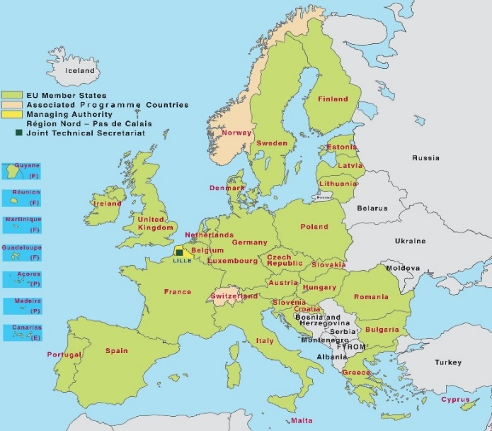
Interreg Europe
2 interrelated actions
Policy Learning Platforms
Open to all regions
Enrich
Contribute
Interregional cooperation projects
Project 1
Project 2
Project 3

Slide 19
Interreg Europe
Conclusions
 | INTERREG IVC | Interreg Europe
Rationale | Regional development policies | Regional development policies, principally SF programmes
Area | EU-27, NO+CH | EU-28, NO+CH
Eligibility | Public & public law bodies No private | Public & public law bodies Private non-profit bodies
Co-financing | 75%-85% (country) | 85% public or equivalent 75% private non-profit
Actions | 1-phase project + CAP | 2-phase project + PLP

Slide 21
Thank you for your attention!

