Slide 1
Bridgıng the Gap
International Research Activities by
Small and Medium-Sized Enterprises
Jenny Gudlat
Network Coordinator
www.ira-sme.net

Slide 2
HOW IRASME IS STRUCTURED
Network of ministries and funding agencies
Synchronized national funding for transnational R&D projects
National / regional funding conditions are binding
Coordination office is based at AiF Projekt GmbH in Berlin, supported by German Federal Ministry for Economic Affairs and Climate Action (BMWK)

Slide 3

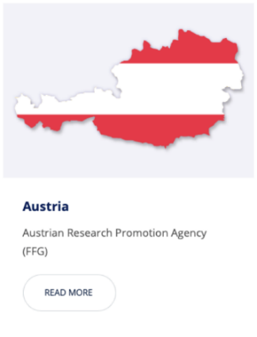
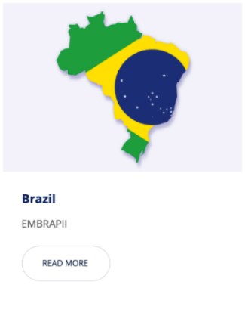
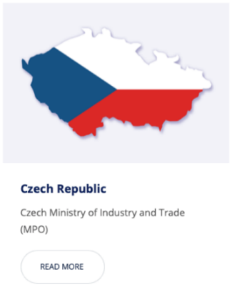

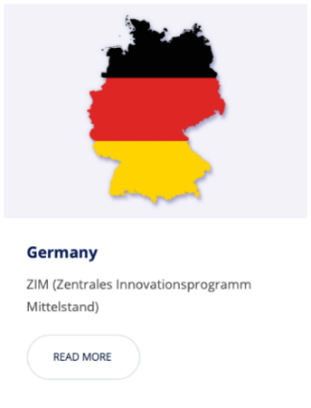




COUNTRIES / REGIONS
suspended

Slide 4


PROJECT REQUIREMENTS
Development of new or significant improvement
of existing products, processes and technical services
  Bottom-up approach
  Up to prototype level (TRL 4-7)
  Significant technical risks for each partner
High market potential

Slide 5

JOINT CALLS FOR PROPOSALS
Two calls for proposals per year
  Deadlines end of March and September
  30th call: June 2022 until 28 September 2022
    Without Alberta (Canada), Austria
  31st call: December 2022 until 29 March 2022
  Documents: IraSME proposal application form + national application form
National Programme Portraits
on IraSME website: www.ira-sme.net
Notes:
VLAIO = Flanders Innovation & Entrepreneurship

Slide 6
APPLICATION FORM

Slide 7



A TYPICAL IRASME PROJECT
2-6 participants – clearly distinct subprojects for each partner
2 SMEs / 2 participating countries / regions
→ RTOs as additional partners or subcontractors
→ Brazil: + EMBRAPII unit!
average project partner costs €150,000 – €250,000
average duration 26 months

Slide 8
WATCH OUT!
Most common reasons for weak proposals:
Lack of knowledge of national funding programme
Lack of time to write acceptable project plan and application

Slide 9
WE CAN HELP!
Best measures to overcome those problems:
Contact your national / regional funding organization at
an early stage
Take your time! Two calls each year – no need to rush or worry about a missed deadline

Slide 10
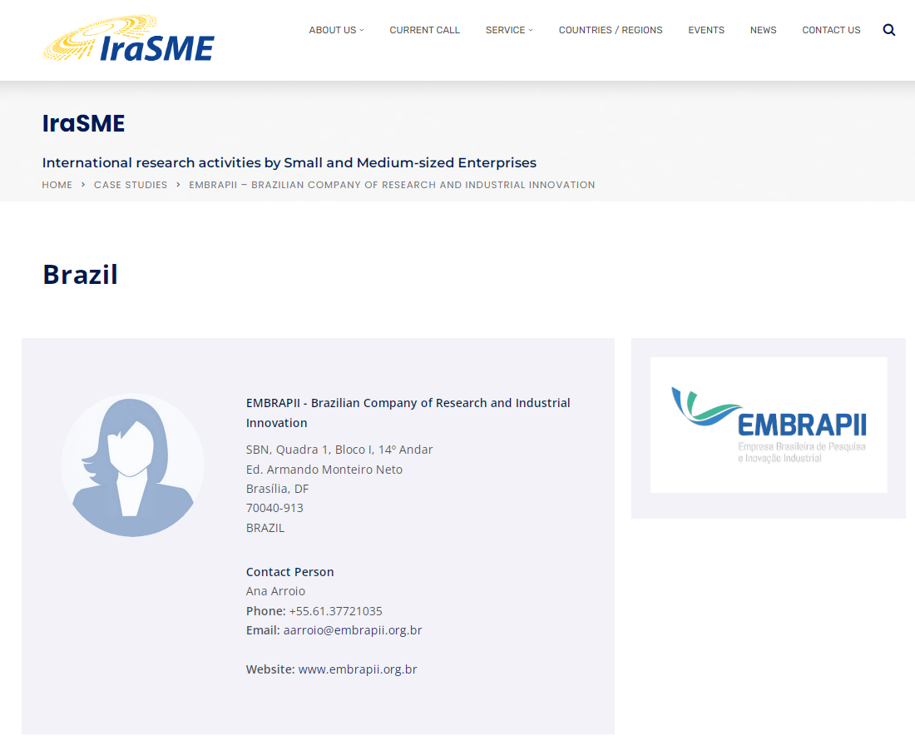
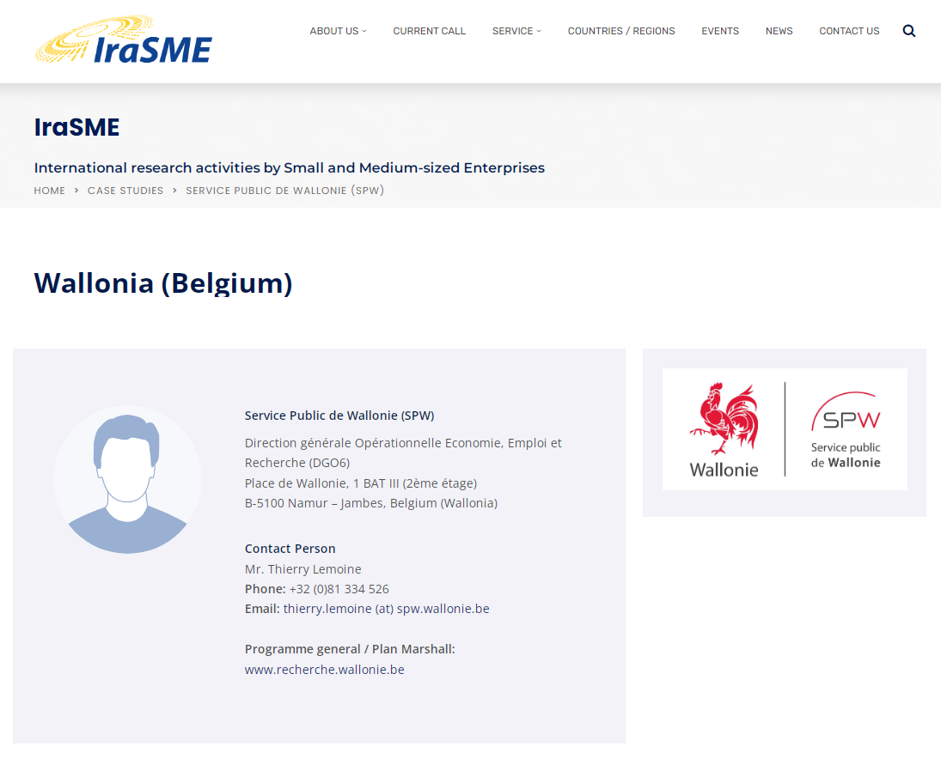
WE CAN HELP!
Please contact the IraSME coordination office
and your local funding agency.
E-mail: info@ira-sme.net
Phone: +49 30 48163 589
Web: www.ira-sme.net/countries-regions

Slide 11
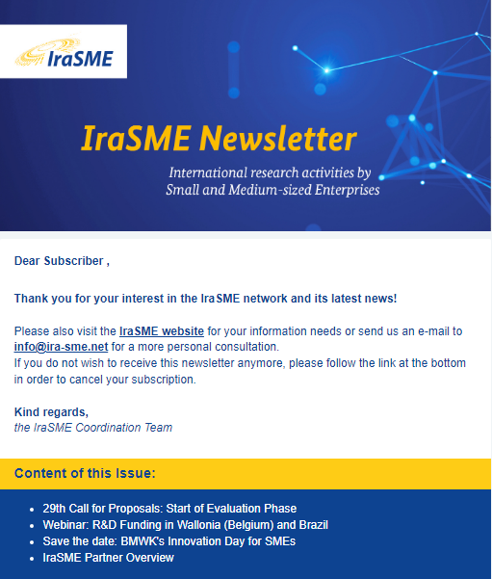
KEEP INFORMED!
For call and events announcements,
please subscribe to the IraSME newsletter!
Web: www.ira-sme.net

Slide 12
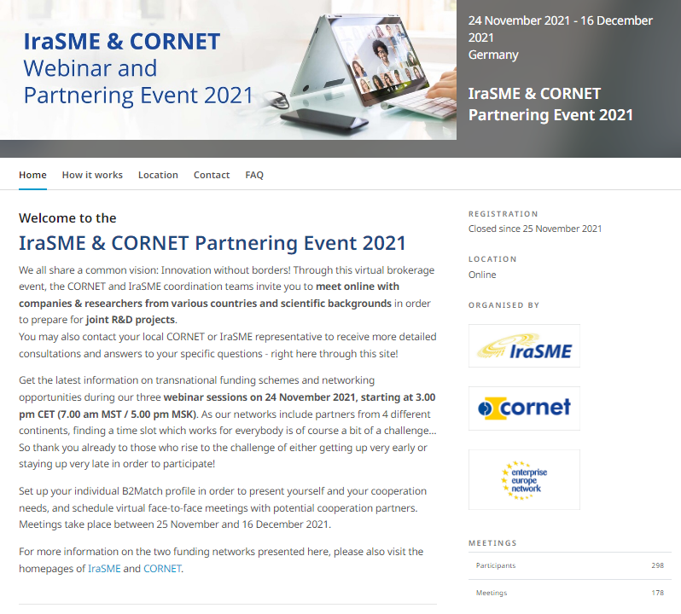
EVENTS
IraSME / CORNET Partnering Events
1-2 per year at alternating locations (or online via B2Match)
CORNET = Collective Research Networking
(https://cornet.online)
Funding iniatives, matchmaking, elevator pitch sessions, success stories
Notes:
CORNET is a network of ministries and funding agencies that combine their existing funding schemes to increase the competitiveness of small and medium-sized enterprises (SMEs): pre-competitive Collective Research.

Slide 13
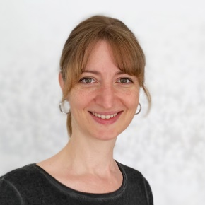
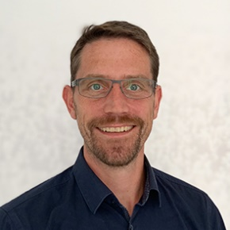


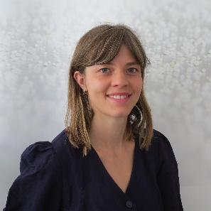
CONTACT
IraSME coordination office
at
E-mail: info@ira-sme.net
Phone: +49 30 48163-589
Web: www.ira-sme.net
Jenny Gudlat
Georg Nagel
Christian Fichtner
Paula Schnippering

Slide 14
Thank you for your attention!

