Slide 1
“Do you read le belge?”
A selection of ten novels
Written by francophone Belgian authors
Some published in Belgium...
... and others in France
& released between November 2018 and October 2020

Slide 2
>>> Before we start…<<<
Please switch off your microphones to avoid interference noise
The webinar is recorded: if you do not want to appear, please switch off your webcam
If you have any questions during the presentation, please use the chat: we will answer them at the end of the webinar

Slide 3
>>>Programme (1h)<<<
Who are we ?
Presentation of 10 books by WBI Academic & Cultural Liaison Officers
Presentation of translation grants
Presentation of additional support available
Question & Answer Session

Slide 4
Who are we?
2 entities working together for the international promotion of Belgian francophone books : the Ministry of Culture and Wallonia-Brussels International (WBI)
WBI's mission is to increase the impact, influence and reputation of the Wallonia-Brussels area and of its representatives (creators, artists, entrepreneurs, students, higher education institutions, researchers, etc.)
Network of General Delegations with diplomatic status in: Berlin, Bucharest, Dakar, Geneva, Hanoi, Kinshasa, the Hague, Paris, Beijing, Québec, Rabat, Santiago de Chile, Tunis, Warsaw and Brussels (Representation to the European Union).
Several sectoral networks abroad including the Academic and Cultural Liaison Officers based in South Africa, Brazil, Chile, China, Croatia, Hungary, Japan, Lithuania, Poland, the United Kingdom and Serbia.

Slide 5
Mademoiselle Papillon by Alia Cardyn Editions Robert Laffont (France) - Novel
In the top ten best-sellers (Fnac Belgium & Club bookshops)
Publisher Robert Laffont: popular fiction, page turners
Intertwines stories of two nurses: present-day and interwar period
Major themes examined by the author: exploring an unknown past, family histories, motherhood
Women's fiction with key ingredients for publishing success: fulfilment and self-discovery, search for meaning, romance
“The writing is crafted, vivacious and intense” Michel Dufranne – RTBF and La Première
“A work of art” Aurélia Dejond – Marie Claire Belgique

Slide 6
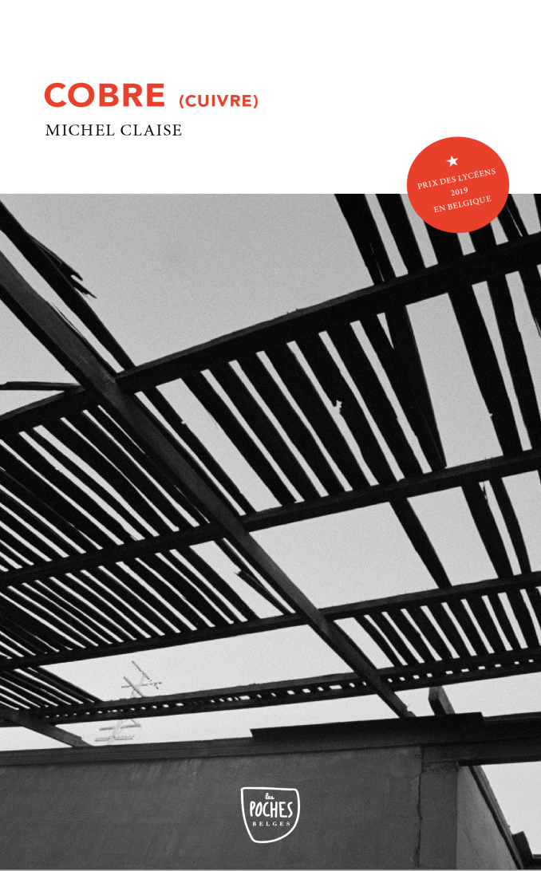
Cobre (“Copper”) by Michel Claise
Genèse Editions (Belgium) – Novel // pocket edition
The author is a very famous judge in Belgium specialised in white-collar crime
The novel won the 2019 “Prix des lycéens” (High School Students Prize) in Belgium
Historical and humanist novel in Chile with strong characters
Spiritual dimension (metamorphosis and copper metaphors, Pachamama, shamanism…)
A book that emphasizes the necessary duty of memory
An effective suspense
A beautiful balance of composition between intense human emotions, political views and initiatory journey

Slide 7
Bluebird by Geneviève Damas
Gallimard (France) – Novel
A multi-awarded author whose work is translated in many countries
4th novel of the author: an exploration of a teenager’s denial pregnancy written as a long letter to the upcoming baby
The author continues to do what she is best at: giving a voice to the voiceless, linking intimacy with societal questions and gathering love gems in the most desperate situations
“This beautiful novel shares the questions of a teenager who denies her pregnancy. Fascinating.” Les Inrockuptibles

Slide 8
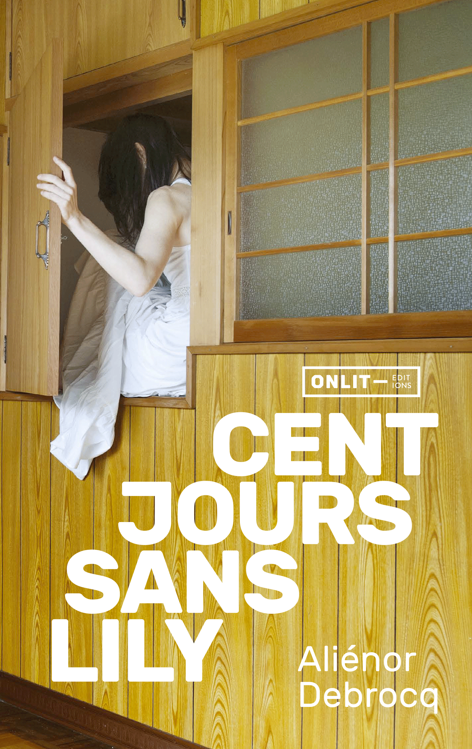
Cent jours sans Lily (“A Hundred Days Without Lily”) by Aliénor Debrocq
Editions Onlit (Belgium) - Novel
A young and dynamic publishing house in francophone Belgium
The author won several prizes in Belgium with her previous short stories books
Author’s second novel : she takes up the challenge successfully as shown by the press release (available on onlit.net)
A book that combines 2 aspects: a good detective novel & breathless page turner and an experimental dimension
Complex and endearing life stories
A feminist reflection on the difficulty of combining motherhood and writing, on women's desire, on women's bodies

Slide 9
Le Second disciple (“The Second Disciple”) by Kenan Görgün Editions Les Arènes (France) - Novel
First book of a trilogy
A new publishing house for this author: a new writing approach
Foreign publishers from Germany, UK and Italy showed an interest in publishing the novel in their country
Brussels landscapes and sociological context depicted by an author who grew up there
The reverse destinies of two complex characters
Several aspects : the book is a thriller as well as a naturalist novel with multiple points of view strengthened by action scenes and even poetry writing

Slide 10
Feel Good by Thomas Gunzig
Editions Le Diable Vauvert (France) - Novel
A multi-awarded author whose work has been translated in Bulgaria, Spain, Germany, Italy, Korea, China, Russia, Czech Republic, Macedonia and Armenia.
Top 20 sales in Fnac in 2019
This book has been published in Italy in September 2020 and will be in Russia soon
An unconventional « feel good book » mixing black humour, criticism of today's society, caricature of the publishing world and mockery of all kinds
A both ironic and gentle painting about the world of books offering a meta-novel of a frank and unadorned view of the publishing world
“Thomas Gunzig is in a great shape and signs a real feel good book” Libération

Slide 11
Les Yeux rouges (“Red Eyes”) by Myriam Leroy
Editions du Seuil (France) - Novel
A famous journalist in Belgium known for her strong feminist statements
Top 20 sales in Fnac bookshops in 2019
The author explores the world of journalism and the excesses that celebrity can create
An original way of writing about social network harassment and its dangers – based on a real life experience
“Myriam Leroy depicts in a brilliant way the frightening mechanism of the online harassment – that is to say the other face of mysogyny” Anne Laffeter in Le Nouveau Magazine littéraire

Slide 12
Un Monde sur mesure (“A tailor-made World”) by Nathalie Skowronek
Editions Grasset (France) - Novel
The author won last spring the European Union Prize for Belgium with her latest book
Third book of a trilogy family from the Shtetls in Poland to the Sentier neighbourhood in Paris
Rich and original intertextuality referring to the garment industry
Subtle language and metaphors creating a fabric of Jewish generations after the Shoah
Original parallel between clothes and people through the modern era
Birth of an author from this complex microcosm and quest for identity

Slide 13
Poney flottant (“Floating Pony”) by Isabelle Wéry
Editions Onlit (Belgium) - Novel
A young and dynamic publishing house in francophone Belgium
Isabelle Wery’s previous novel won the European Union Prize for Literature in 2015 and has been translated into 10 languages
This novel was shortlisted for the Rossel Prize 2019
A surprising title referring to the narrator, Sweetie Horn, a small English fictional writer
Very poetic, even surrealist writing; language very close to orality
Voice of the book is a sharp-tongued protagonist: provocative passages & a feminist voice
Literary experimentation and captivating plot

Slide 14
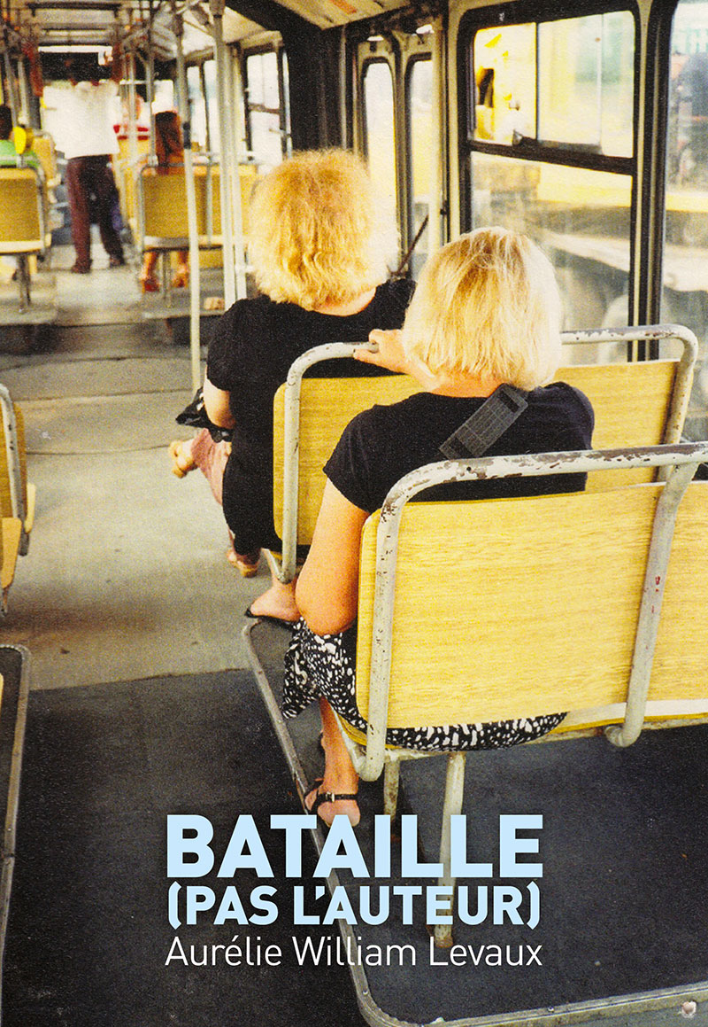
Bataille (pas l’auteur) (“Bataille (Not the Author)”) by Aurélie William Levaux
Editions Cambourakis (France) - Novel
First novel of an author who could be qualified as a “Queen of anecdotes” (you can follow her on Facebook to discover her weekly notes)
Everyday life scenes written like a diary with a sharp sense of humour - developed as the best way to save herself and us
The author tackles difficult subjects, such as love and relationship problems, motherhood, depression, disability
“Each of the texts which make up this collection by Aurélie William Levaux tells the odyssey of a detail, forcing the narrator to hesitate, digress, get lost and take the scenic route with us. The world may seem simple, but that’s because we don’t know how to read between the lines”, Claro in Le Monde

Slide 15
Translation grants and residency for translators

Slide 16
About
The Department for Literary Promotion supports the translation of literary works, written by French speaking Belgian authors from the Wallonia-Brussels Federation.
Foreign publishers can apply for financial assistance to cover 75% of the translation costs.
Grants are limited to the actual cost of translation, taking into account current translation rates in the country in question.
Classic texts : the financial assistance will be up to 50% of the translation costs.

Slide 17
Publishers
They hold the rights for the work ;
There is a translation contract with a professional translator;
Active promotion is organized to promote the book and the author (press events, conferences, signing, etc.)
CRITERIA
The proficiency of the translator;
The quality of the editorial project;
The cost for the translation (the translator needs to be paid fairly)
The economic and commercial viability of the project (selling price, target audience , dissemination);
The will to invite the author to meetings or signing session during literary events;
The quality of the promotion project for the translated work ;

Slide 18
The procedure
Application form
Three calls a year (new commission for 2021) : February, June, October
Once the commission has agreed to the grant, the application is then forwarded to the Minister of Culture who gives the final agreement.
The publisher is being informed of the decision and the payment is due.

Slide 19
Residency for literary translators
Every year in August, a residency welcomes translators from all over the world.
Dedicated to translators working on Belgian projects, from French to other languages.
New Direction, new projects since 2018.
annelise.remacle@passaporta.be

Slide 20
Travels grants & support for the transfer of rights (WBI)
Those grants are intended for professionals based in Wallonia-Brussels Federation. However, if you wish to purchase the rights of a book published in francophone Belgium or if you wish to invite a French speaking Belgian author, please contact Marie-Eve Tossani, in charge of international promotion of books & literatures in WBI.

Slide 21
Thank you!

